Slide 1
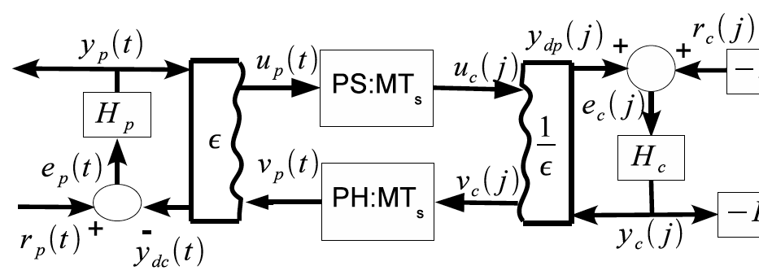
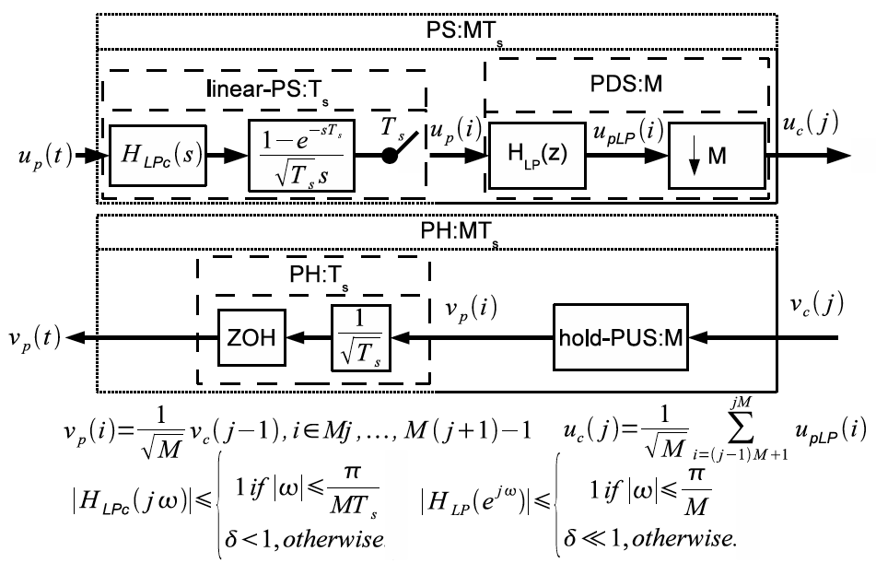
Networked Control of "m-Triangular Systems“ (mTS) Nicholas Kottenstette, Heath LeBlanc, Emeka Eyisi, Joe Porter Vanderbilt - ISIS
Objective: To provide a constructive framework for networked control complex cyber-physical systems (CPS) such as (quadrotor) aircraft.
Highlights:
mTS are nonlinear affine Physical Systems
mTS formulation allows for well-posed, distributed, (adaptive) control laws
Approach: 1. Render mTS system to be strictly-output passive (sop) with novel nonlinear control law; 2. Integrate sop subsystem into digital networked control architecture.
Results
Can be applied to Hammerstein systems
Can tolerate arbitrary networked delay, data loss, and sampling rates
Obvious performance trade-off (Nyquist)
Allows for Discrete-Time PID control
Highlights of Relevant Publications:
A Backstepping Control Framework for Networked Control of m-Triangular Systems (TCST – (under review))
Passivity-Based Design of Wireless Networked Control Systems Subject to Time-Varying Delays (TCST – (provisionally accepted))
Notes:
This result applies to networked control of non-linear affine systems, including fixed wing aircraft, quadrotor aircraft, robotic, thermal, semiconductor manufacturing, alternative energy generation, digital signal processing, and suspension systems. These nonlinear affine systems can be expressed through what we term "m-Triangular Systems". The m-Triangular System renders possible a well-posed, distributed, continuous-time, control law which can be applied to nonlinear affine systems. This control law creates a strictly-output passive system which can then be integrated into a multirate discrete time networked control architecture. This robust architecture permits a discrete time strictly passive lag compensator to determine the desired output of the strictly-output passive system. Thus, we can integrate unmanned jet fighter aircraft into the NextGen system in which the lag compensator is located at the ground-control station. We can now safely control the inertial position of these aircraft despite communication time varying delays and data loss.

Slide 2
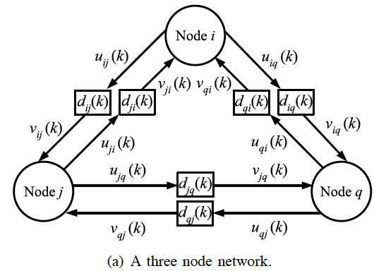
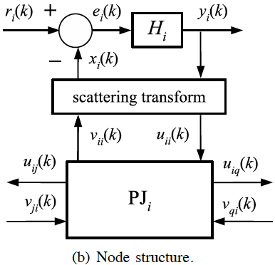
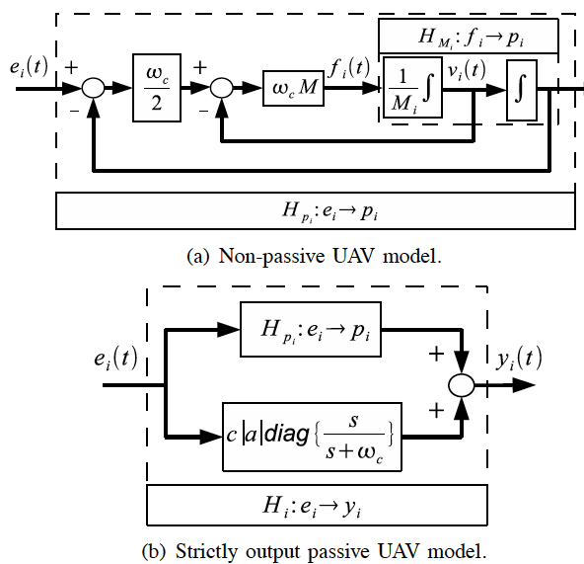
A Passivity-Based Approach To Deployment of Quadrotor Aircraft In Multi-Agent Networks (MA-Nets) N. Kottenstette, H. LeBlanc, E. Eyisi, G. Hemingway, X. Koutsoukos, J. Sztipanovits
Objective: To provide a constructive networked control framework of multiple complex cyber-physical systems (CPS) including aircraft.
Highlights:
General abstraction known as power junction (PJ) allows for MA-Nets control
Simulations indicate promising results
Approach: 1. Render mTS system to be strictly-output passive (sop) with novel nonlinear control law; 2. Integrate sop subsystem into digital PJ networked control architecture; 3. Apply non-linear filter to classic collision avoidance alg. to achieve formation.
Results
Can be applied to Hammerstein systems
Ensure stability regardless of overlay network topologies
Digital Control of Multiple Discrete Passive Plants Over Networks (IJSCC – 2011)
A Passivity-Based Approach To Deployment In Multi-Agent Networks (Springer, Berlin)

